Slide 1
Community Map Night
October 14, 2025

Slide 2
Outline
https://www.alleghenycounty.us/Services/Human-Services-DHS/Publications/Resource-Guides
https://www.alleghenycounty.us/files/assets/county/v/1/services/dhs/documents/resource-guides/resource-guide_link.pdf

Slide 3
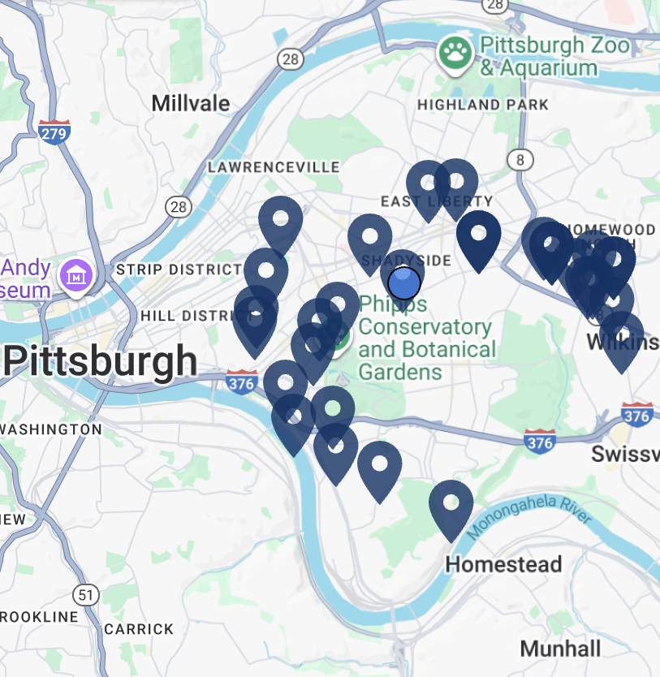
Basic Needs
Red Door
Shepherd's Heart Church breakfast (open before 2AC engagement center)
DHS building One Smithfield St
Jubilee Kitchen
First United Methodist Church of Pittsburgh
Greater Pittsburgh Community Food Bank
SNAP
https://findfood.pittsburghfoodbank.org/

Slide 4
Health & Medical Care
Second Avenue Clinic
Birmingham Free Clinic
Alma Illery
Allegheny County Health Department Clinics
Vaccines, Lung health/disease, Sexual health, WIC
Pittsburgh Mercy
resolve Crisis Services

Slide 5
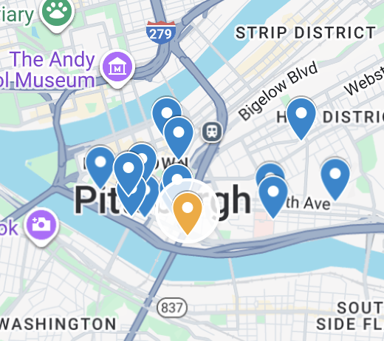
Second Avenue Shelter and Clinic
92-bed year-round, low-barrier shelter
Beds usually full
UPMC Clinic: Monday – Friday: 9am to 5pm
Engagement Center: Monday – Sunday: 7am to 7pm
We refer for:
Case management and housing intake
SNAP, ID/legal services, transportation
Specialty care (SUD, mental health, etc)
Acute and chronic medical care
Vascular Screening
700 Second Avenue
Pittsburgh, PA 15219
412-232-7544

Slide 6
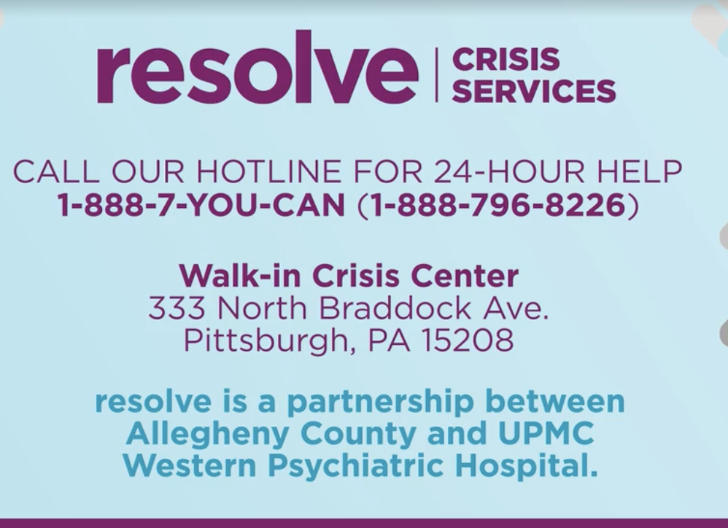
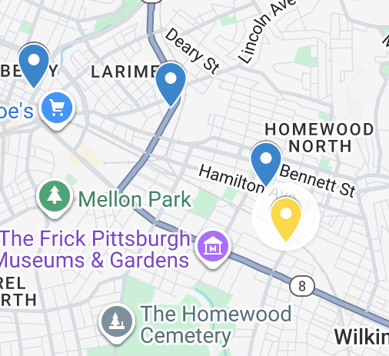
Resolve Crisis Center
24-hour, 365-day crisis service free to all Allegheny County residents
24 hour hotline and mobile crisis team
We refer for:
Emergency and non emergency mental health
Wellness checks via mobile crisis unit
333 North Braddock Ave.
Pittsburgh, PA 15208
Resolve Crisis Services hotline:1-888-796-8226

Slide 7
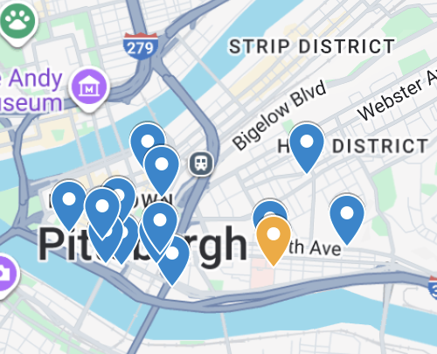
Birmingham Free Clinic
founded in 1994: free, compassionate health care services within the Pittsburgh community to provide a safety net of care for homeless, uninsured and medically indigent individuals
Call for an appointment
We refer for:
Medications for rounds
Medical care for the uninsured
1515 Locust St Suite 705, Pittsburgh, PA 15219
(412)-246-3053

Slide 8
Identification Support
2AC Roots clinic and DHS Link / Field Unit staff at One Smithfield Street can sign certification for free PA Birth Certificate
Free PA birth certificate requires certification of client’s homeless status by social worker, representing attorney, or director of facility where client is receiving services
(Requires copy of signing worker’s state ID, letter on org’s letterhead, and copy of staff ID badge where applicable)
Fee Waiver for PA State ID or Driver’s license requires client’s mailing address be at a shelter or service provider, letter from the facility certifying client receives mail there

Slide 9
Other Legal Issues
Criminal cases and expungements
Allegheny County Public Defender
Other legal issues
Neighborhood Legal Services Association
866-761-6572
928 Penn Avenue Pittsburgh, PA 15222
Allegheny County Bar Foundation Lawyer Referral Project

Slide 10
Harm Reduction + Public Health
Prevention Point
Bridge Outreach
Central Outreach
Roots
2AC Clinic

Slide 11

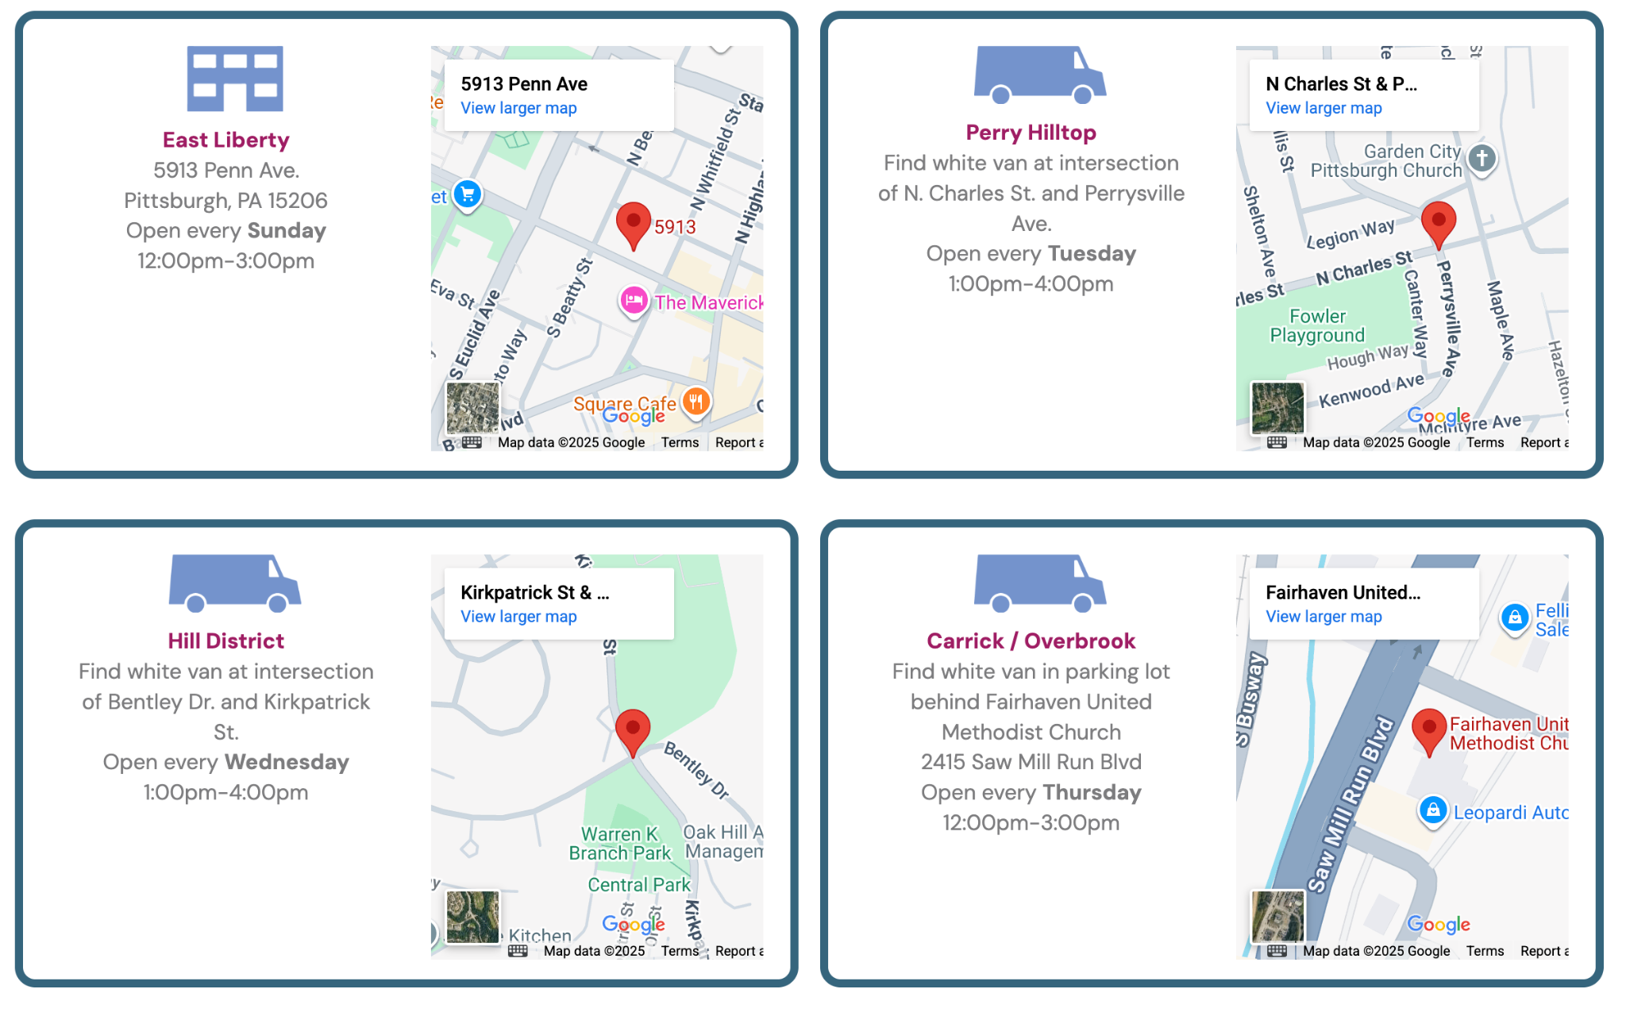
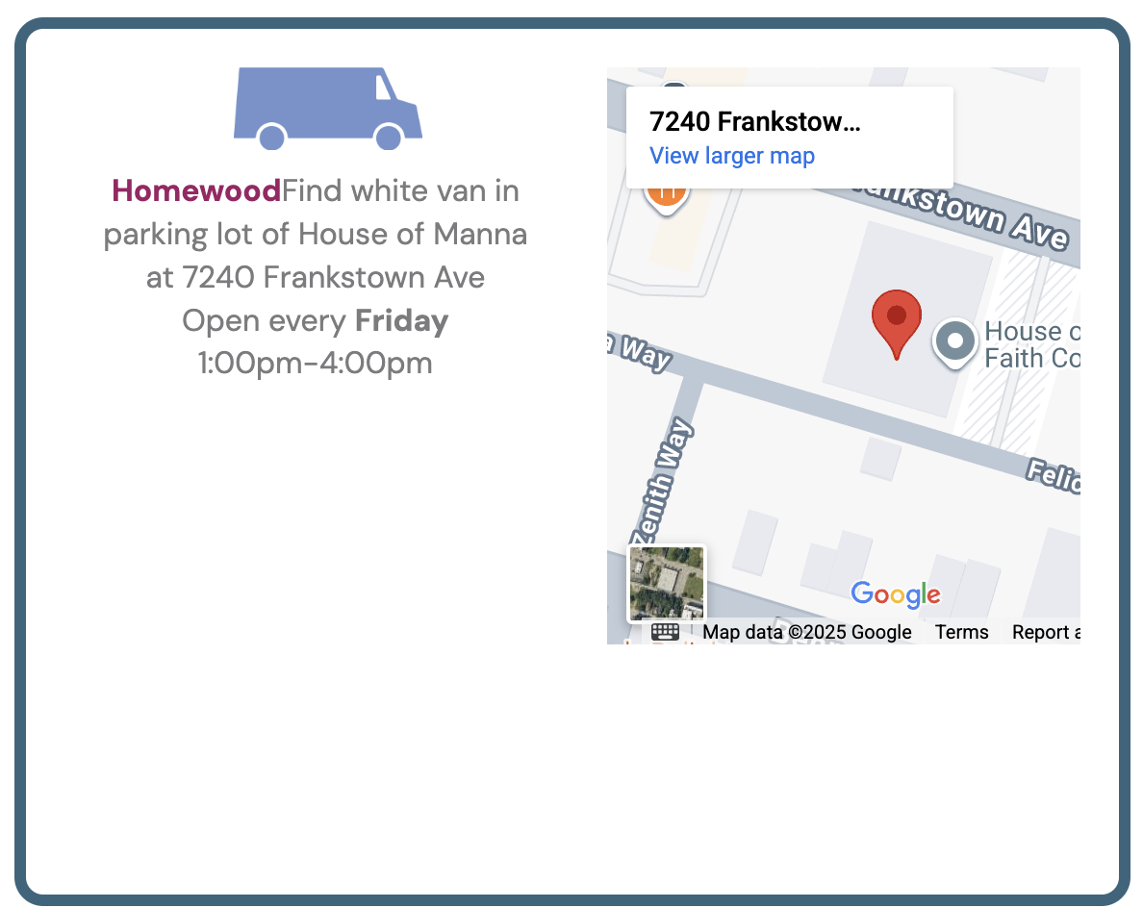
Pittsburgh Prevention Point
5 mobile van locations:
Nonprofit harm-reduction organization serving people who use drugs
Services are free, confidential, and offered both at the office and mobile street sites
Provides clean supplies, naloxone, testing, wound care
We refer for:
Basic medical care/wound/skin infections
Overdose prevention
Testing (HIV, Hep C, STI)
MAT, housing, social services
Main office: 460 Melwood Ave, Lower Level, Pittsburgh, PA 15213

Slide 12

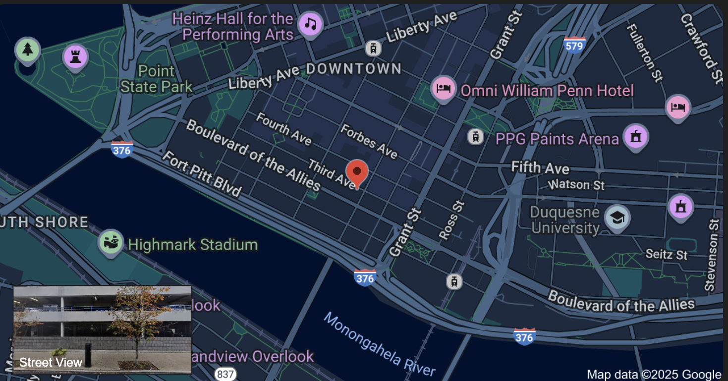
ROOTs
City-run street outreach harm reduction program for those experiencing homelessness
Provides on-site support, basic needs, and connections across Pittsburgh neighborhoods
We refer for:
Human services (IDs, benefits, social support)
Substance use treatment / MAT
Housing resources
Healthcare & behavioral health
Criminal legal navigation
Downtown hub for ROOTs: 213 Smithfield St, Pittsburgh, PA 15222
Current ROOTS sites are located in the Northside, Downtown and East Liberty, respectively in Police Zones 1, 2, and 5.

Slide 13
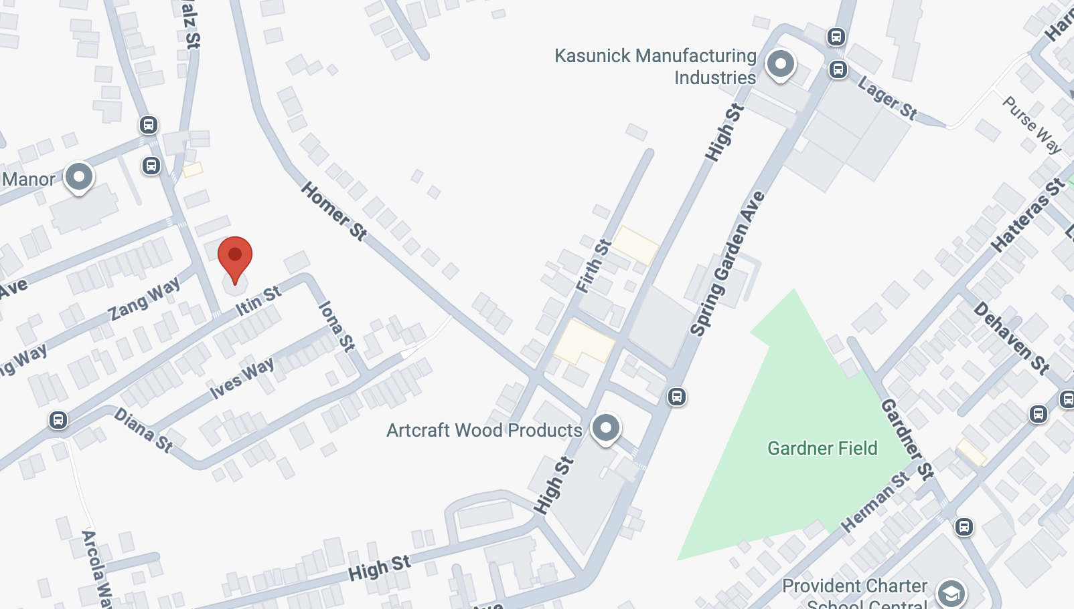
Bridge Outreach
Case Management & Resource Coordination
Photo IDs, birth certificates, SNAP, medical insurance, SSI/SSDI, legal aid
We refer for:
Case management and benefits assistance
Housing coordination and legal aid
Harm reduction and overdose prevention
Medical and psychiatric care
Environmental cleanup and sanitation support
1526 Rhine St. Pittsburgh PA, 15212
(412) 699-0462

Slide 14
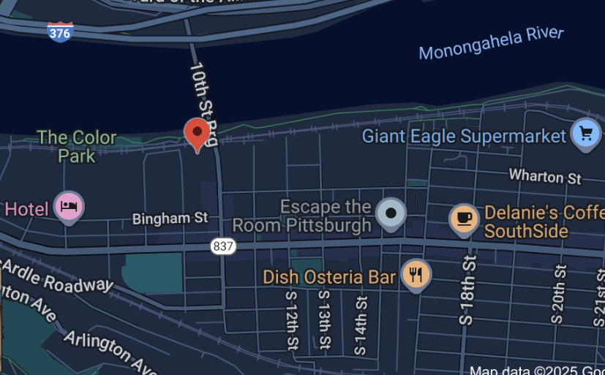
Operation Safety Net
Medical/social service street medicine outreach program run by Pittsburgh Mercy for those experiencing homelessness
Teams make house calls to camps, under bridges, etc.
We refer for:
Medical care
Housing and shelter (linkages)
Legal assistance/social service
Chronic disease management and meds
249 South 9th Street, Second Floor, Pittsburgh PA 15203
412-240-7366

Slide 15
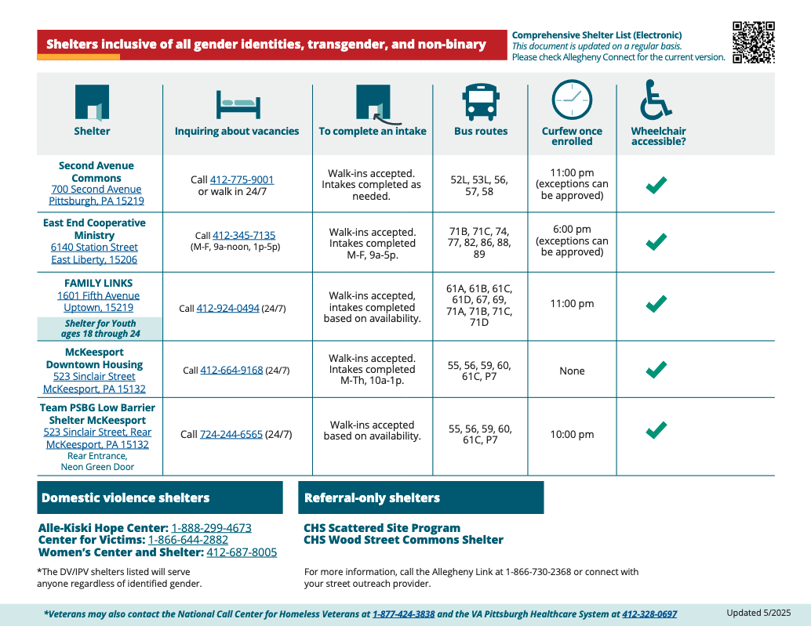
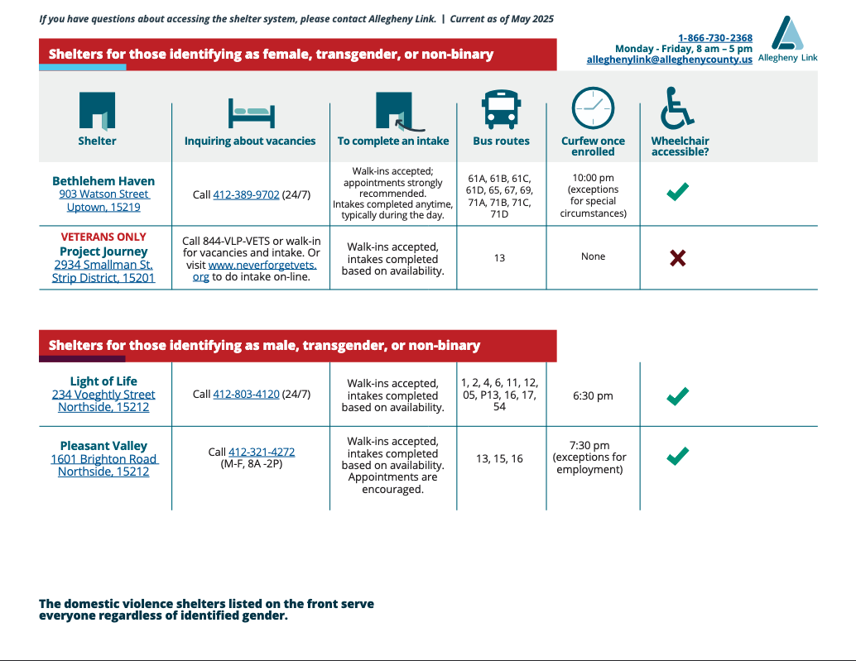
Housing/Reentry: Shelters

Slide 16
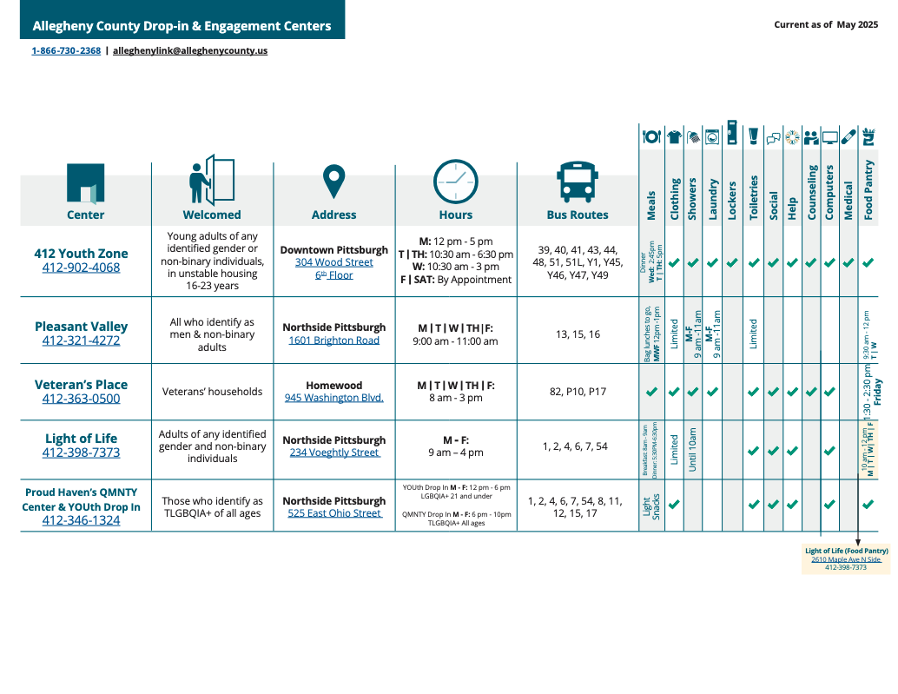
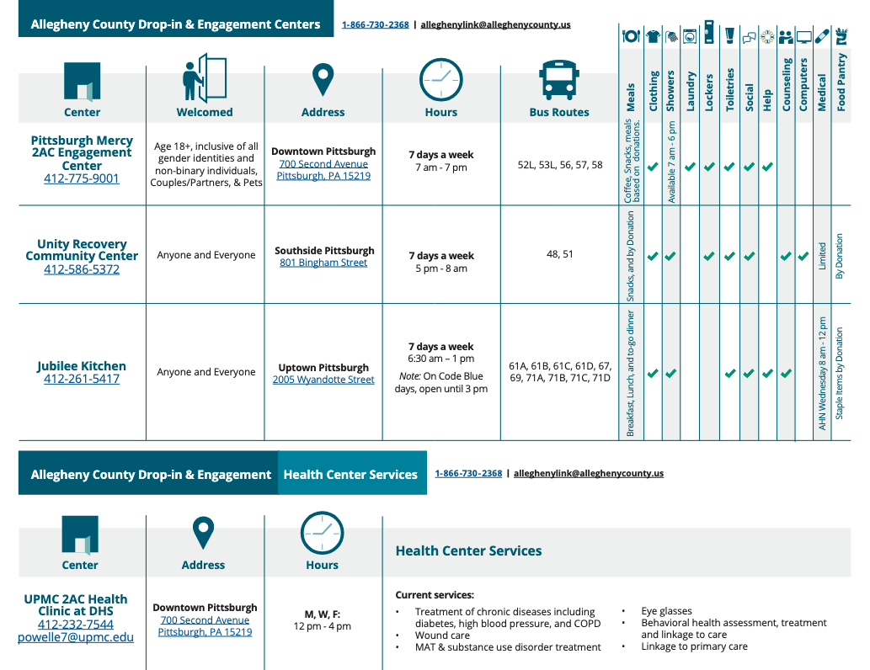
Housing/Reentry: Daytime Services

Slide 17

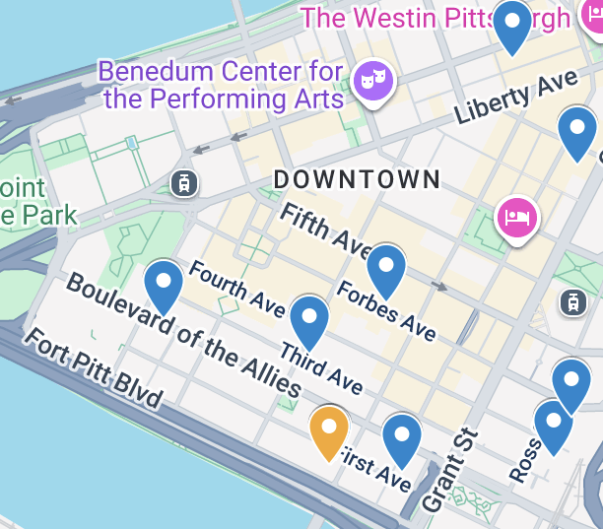
Allegheny Link
Coordinated Entry as the single access point for the Allegheny County Continuum of Care
We email for warm handoff/referrals out on rounds
We refer for:
Screen and intake for homeless housing programs, navigation of affordable housing resources
Access to emergency shelter, rental assistance, homelessness prevention services
Additional resource connection
One Smithfield Street, Pittsburgh 15222
1-866-730-2368

Slide 18
Technology Access
Smithfield Street Public Library (Computer)
DHS Office (Phone)

Slide 19
Outreach Services
Mercy OSN
DHS Field Unit
Bridge (general support for chronically homeless)
Central Outreach
ROOTs (Reaching Out on the Streets)

Slide 20
Upcoming Events
Scenario Night: November 11 WPU 527 at 6 pm
Journal Club #2: November 18 ROOM CHANGE: WPU 540 at 6 pm

